Slide 1
Structured Instrumental Variables for Causal Effect Estimation
By Zongyu Li

Slide 2
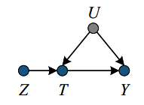
Figure 1 : Treatment T, Outcome Y, Unmeasured factors U and Instrument Z
(i) Z has a causal effect on T
(ii) Z affects the outcome Y only through T (ie, no direct effect of Z on Y, also known as the exclusion restriction)
(iii) Z does not share common causes with the outcome Y (ie, no confounding for the effect of Z on Y)
Hernán M A, Robins J M. Instruments for causal inference: an epidemiologist's dream?[J]. Epidemiology, 2006: 360-372.

Slide 3
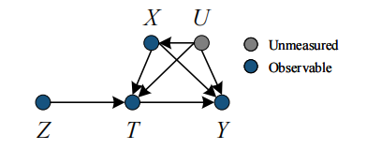
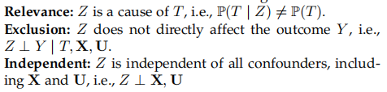
Figure 2 : The causal diagram in more general cases
Wu A, Kuang K, Xiong R, et al. Instrumental Variables in Causal Inference and Machine Learning: A Survey[J]. arXiv preprint arXiv:2212.05778, 2022.

Slide 4
Main Challenges
1.Strict Structural Assumption
Z satisfies three restrictions in the definition,The most common structural assumption is the linearity assumption,which requires that the causal relationships between all variables are linear.
2.Untestable Exclusion and Independent
We do not have access to the unmeasured confounders in observational data, and therefore we cannot test for independence between instrumental and unmeasured variables. In addition, we cannot test whether instrumental variables have additional causality on the outcome variable.
3.Invalid and Weak IV
In instrumental variables regression, the instruments are called weak IV if their correlation with the endogenous regressors is close to zero, or invalid IV if there is a direct effect or a hidden common cause between the instrument and the outcome.
Wu A, Kuang K, Xiong R, et al. Instrumental Variables in Causal Inference and Machine Learning: A Survey[J]. arXiv preprint arXiv:2212.05778, 2022.

Slide 5
For structural assumptions, a substantial number of IV works have been developed to relax the unconfoundedness assumption and the identification assumption for various scenarios.
2SLS(SieveIV,DeepIV,Dual IV,KernelIV,OneSIV,DeepGMM,DFIV,Minimax Approachs,CBIV...)
CFN(TobitModel,ProbitModel,Heterogeneous CFN,Nonparametric BP...)
Although Exclusion and Independent are not testable, thanks to machine learning algorithms, researchers
have developed Summary IV methods to automatically synthesize valid strong instrumental variables from a candidate set of instrumental variables.
IV Synthesis(ModeIV,AutoIV...）
+ Causal Discovery
Wu A, Kuang K, Xiong R, et al. Instrumental Variables in Causal Inference and Machine Learning: A Survey[J]. arXiv preprint arXiv:2212.05778, 2022.

Slide 6
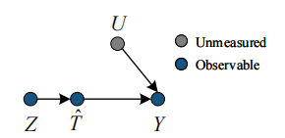
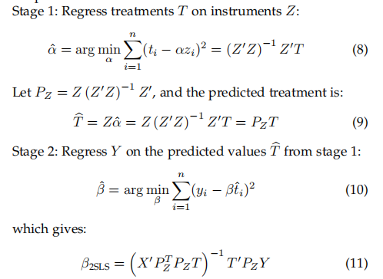
2SLS
Two-Stage Least Squares
Wright P G. Tariff on animal and vegetable oils[J]. 1928.

Slide 7
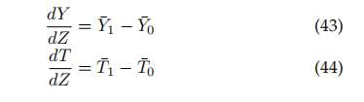

Wald Estimator(linear models)
Denote the sub-sample averages of Y and T by Y¯1 and T¯1 when Z = 1 and by Y¯0 and T¯0 when Z = 0.
Wald Estimator is a binary IV version of 2SLS, under linearity assumption.
Wald A. The fitting of straight lines if both variables are subject to error[J]. The annals of mathematical statistics, 1940, 11(3): 284-300.

Slide 8

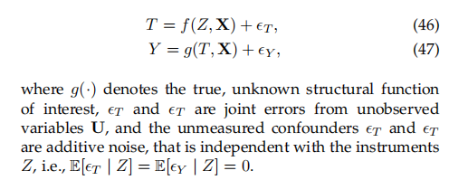
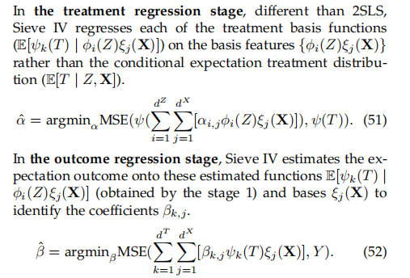
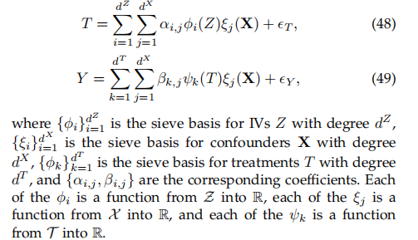
Sieve Estimator(non-linear models)
Sieve IV
Chen X, Shen X. Sieve extremum estimates for weakly dependent data[J]. Econometrica, 1998: 289-314.

Slide 9
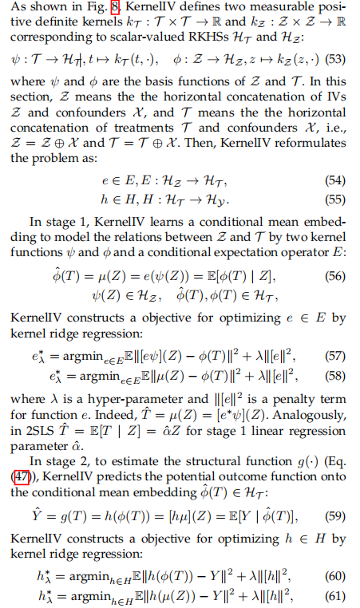
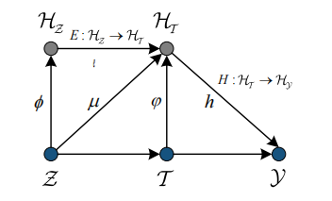

Machine Learning Estimator(Kernel-based)
Kernel IV
Singh R, Sahani M, Gretton A. Kernel instrumental variable regression[J]. Advances in Neural Information Processing Systems, 2019, 32.

Slide 10
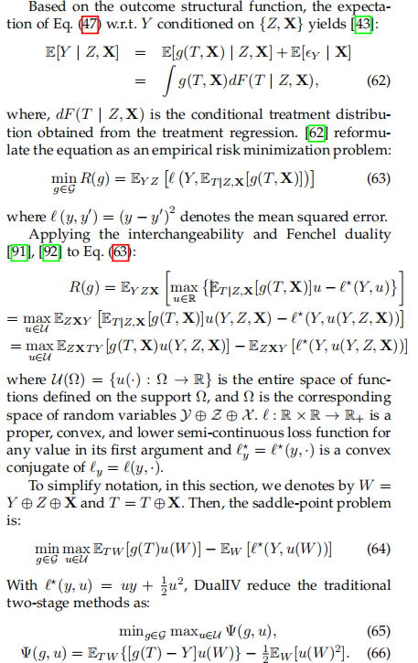
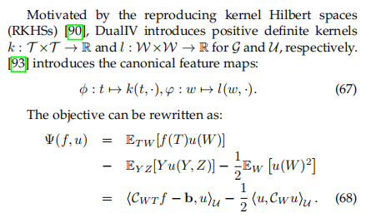
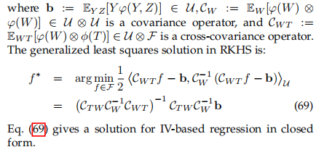
Dual IV
Muandet K, Mehrjou A, Lee S K, et al. Dual instrumental variable regression[J]. Advances in Neural Information Processing Systems, 2020, 33: 2710-2721.

Slide 11
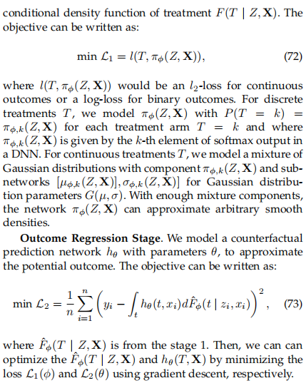
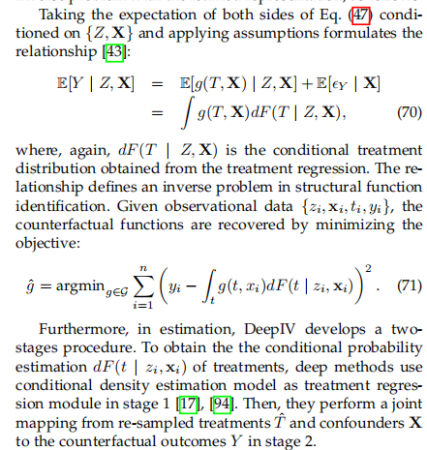
Machine Learning Estimator(Deep-based)
Deep IV
Hartford J, Lewis G, Leyton-Brown K, et al. Deep IV: A flexible approach for counterfactual prediction[C]//International Conference on Machine Learning. PMLR, 2017: 1414-1423.

Slide 12
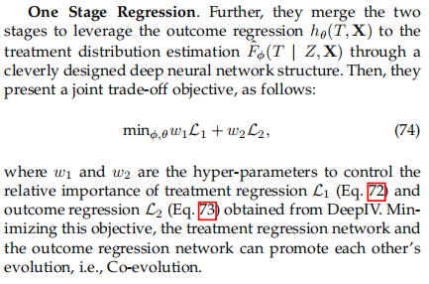
OneSIV
Lin A, Lu J, Xuan J, et al. One-stage deep instrumental variable method for causal inference from observational data[C]//2019 IEEE International Conference on Data Mining (ICDM). IEEE, 2019: 419-428.

Slide 13
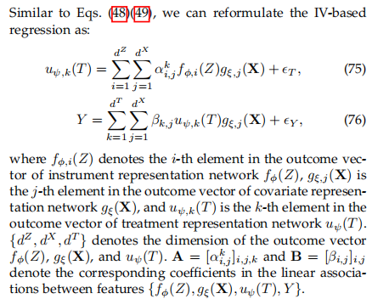
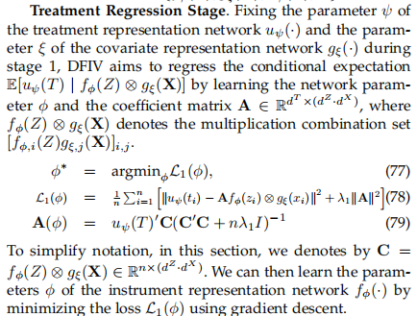
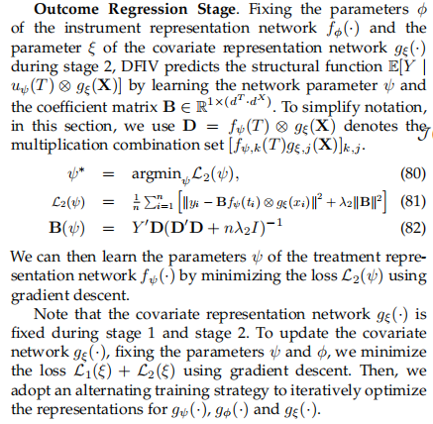
DFIV
Xu L, Chen Y, Srinivasan S, et al. Learning deep features in instrumental variable regression[J]. arXiv preprint arXiv:2010.07154, 2020.

Slide 14
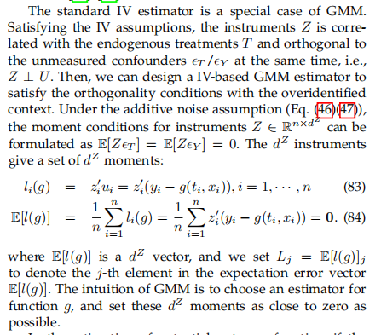
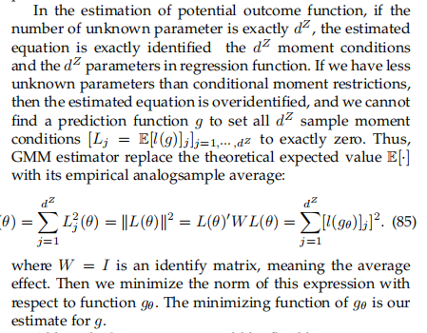
GMM-based Estimator

Slide 15
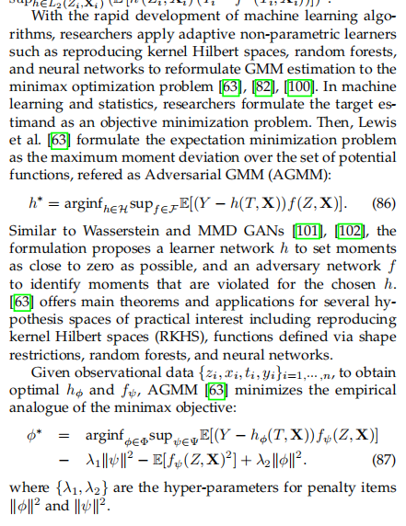
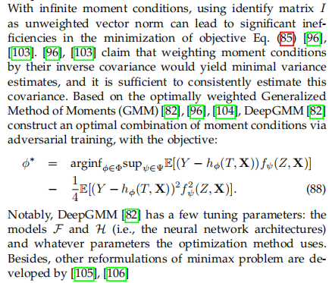
Minimax Approachs
DeepGMM
Dikkala N, Lewis G, Mackey L, et al. Minimax estimation of conditional moment models[J]. Advances in Neural Information Processing Systems, 2020, 33: 12248-12262.
Bennett A, Kallus N, Schnabel T. Deep generalized method of moments for instrumental variable analysis[J]. Advances in neural information processing systems, 2019, 32.

Slide 16
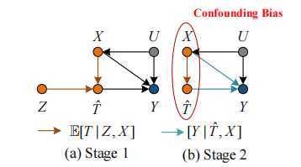
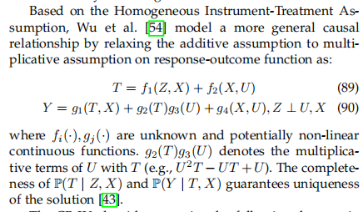
Confounder Balance Estimator
CBIV
Wu A, Kuang K, Li B, et al. Instrumental variable regression with confounder balancing[C]//International Conference on Machine Learning. PMLR, 2022: 24056-24075.

Slide 17
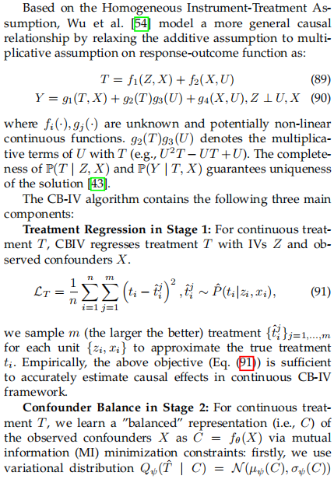
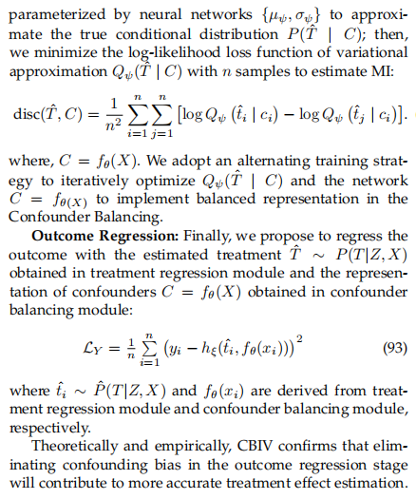
CBIV
Wu A, Kuang K, Li B, et al. Instrumental variable regression with confounder balancing[C]//International Conference on Machine Learning. PMLR, 2022: 24056-24075.

Slide 18
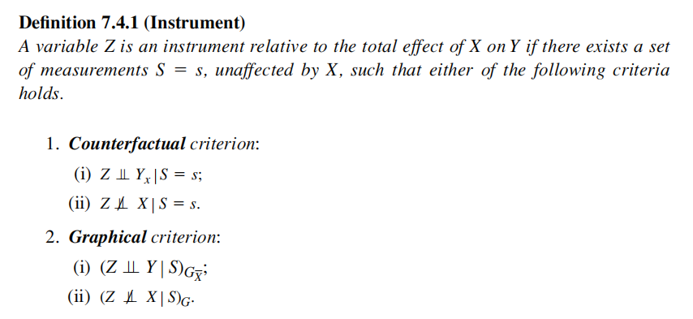
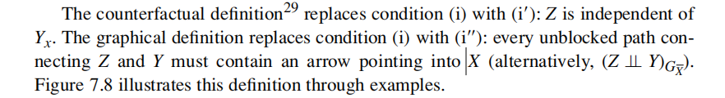
Judea Pearl. Causality. Cambridge university press, Models, Reasoning, and Inference Second Edition, 2009

Slide 19
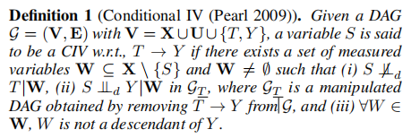
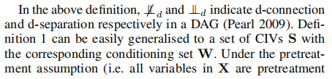
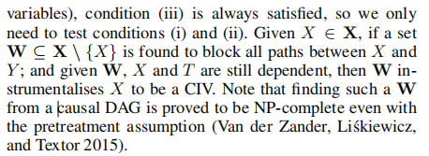
Cheng D, Xu Z, Li J, et al. Causal Inference with Conditional Instruments using Deep Generative Models[J]. arXiv preprint arXiv:2211.16246, 2022.

Slide 20
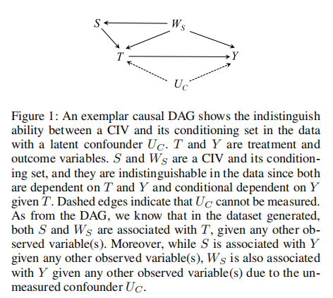
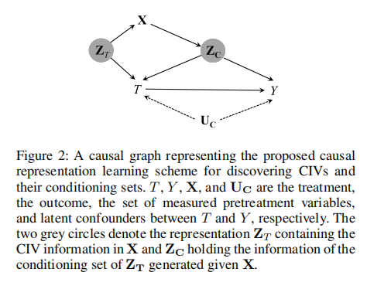
Cheng D, Xu Z, Li J, et al. Causal Inference with Conditional Instruments using Deep Generative Models[J]. arXiv preprint arXiv:2211.16246, 2022.

Slide 21
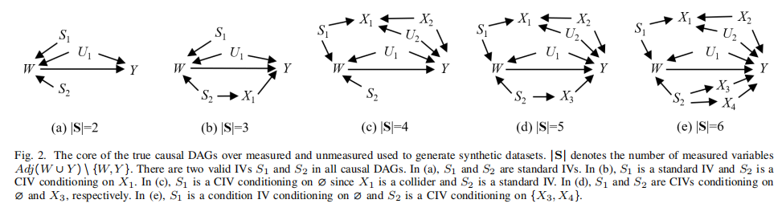
Idea
2SLS通过DAG拓展到更复杂的情况？
KernelIV+CIV？
Cheng D, Li J, Liu L, et al. Discovering ancestral instrumental variables for causal inference from observational data[J]. IEEE Transactions on Neural Networks and Learning Systems, 2023.

